Slide 1
Marks of Authentic Worship
Part One

Slide 4
Isaiah 9:6 (NIV)
For to us a child is born, to us a son is given, and the government will be on his shoulders. And he will be called Wonderful Counselor, Mighty God, Everlasting Father, Prince of Peace.

Slide 5
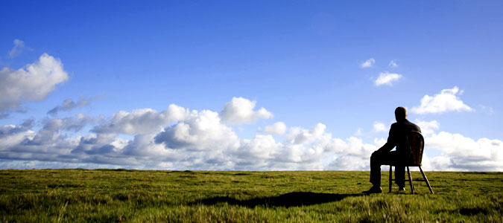
Wonderful Counselor

Slide 6
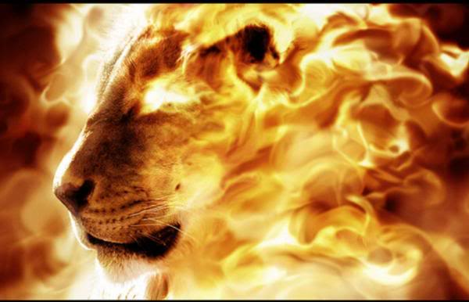
Mighty God

Slide 7
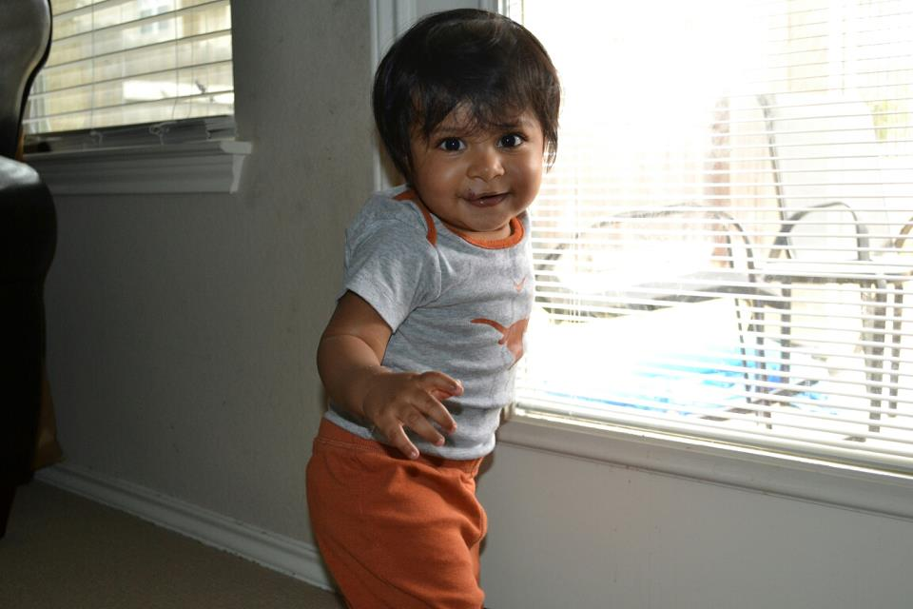
Everlasting
Father

Slide 8
Prince of Peace

Slide 9
Have you lost your wonder of God? Describe why or how.
How has your view of God been changed or refreshed tonight?

