Slide 2
Dismantling
the South Asian American Dream

Slide 3
the dream
1

Slide 4
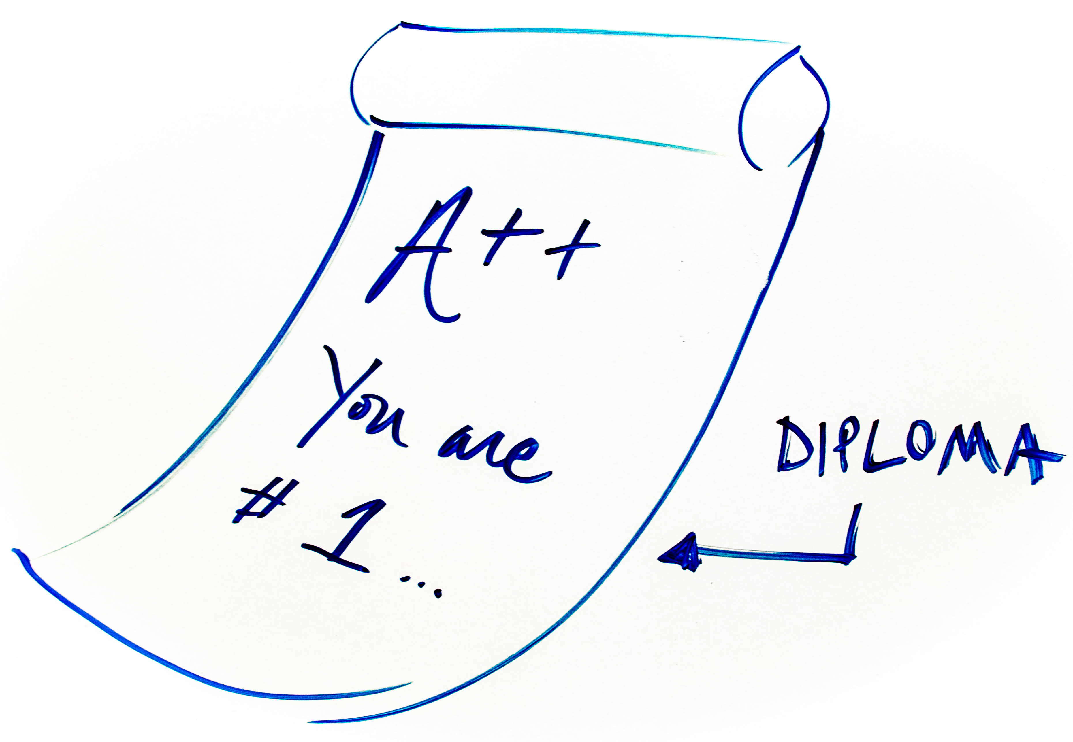
the dream
2
1

Slide 5
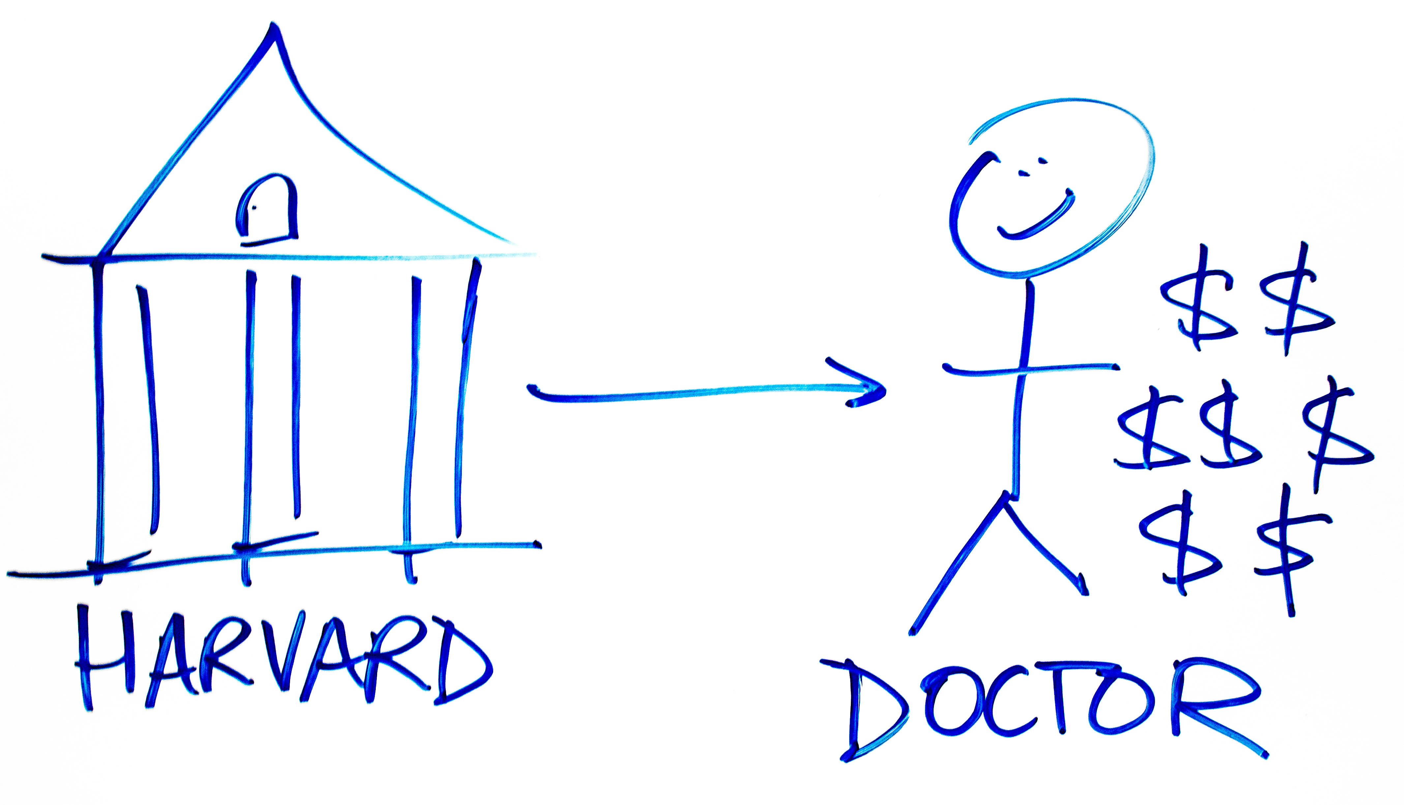
the dream
3
2
1

Slide 6
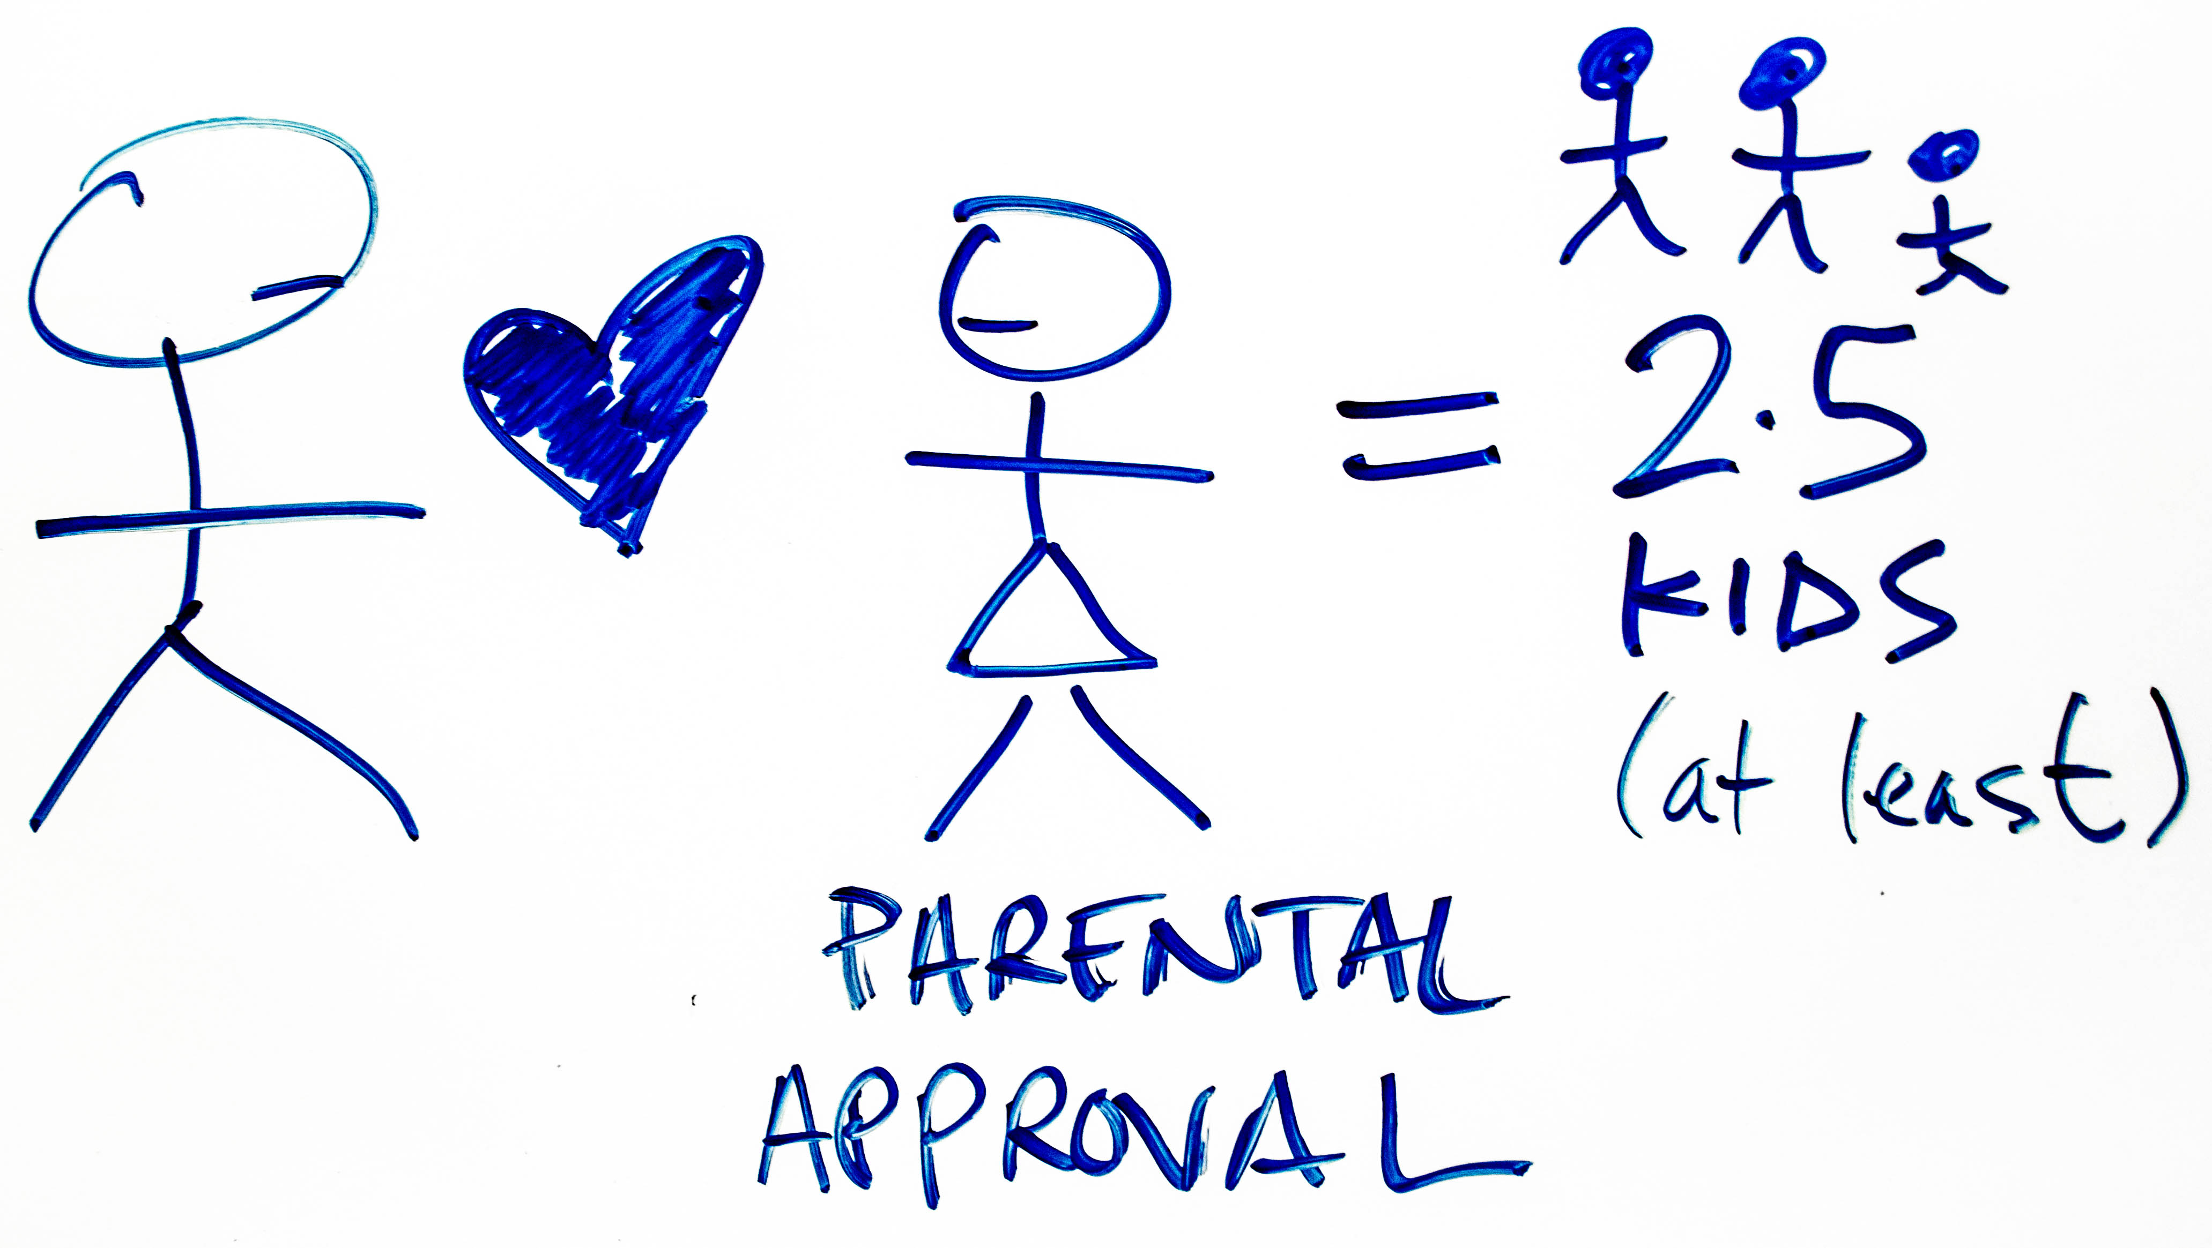
the dream
4
3
2
1

Slide 7
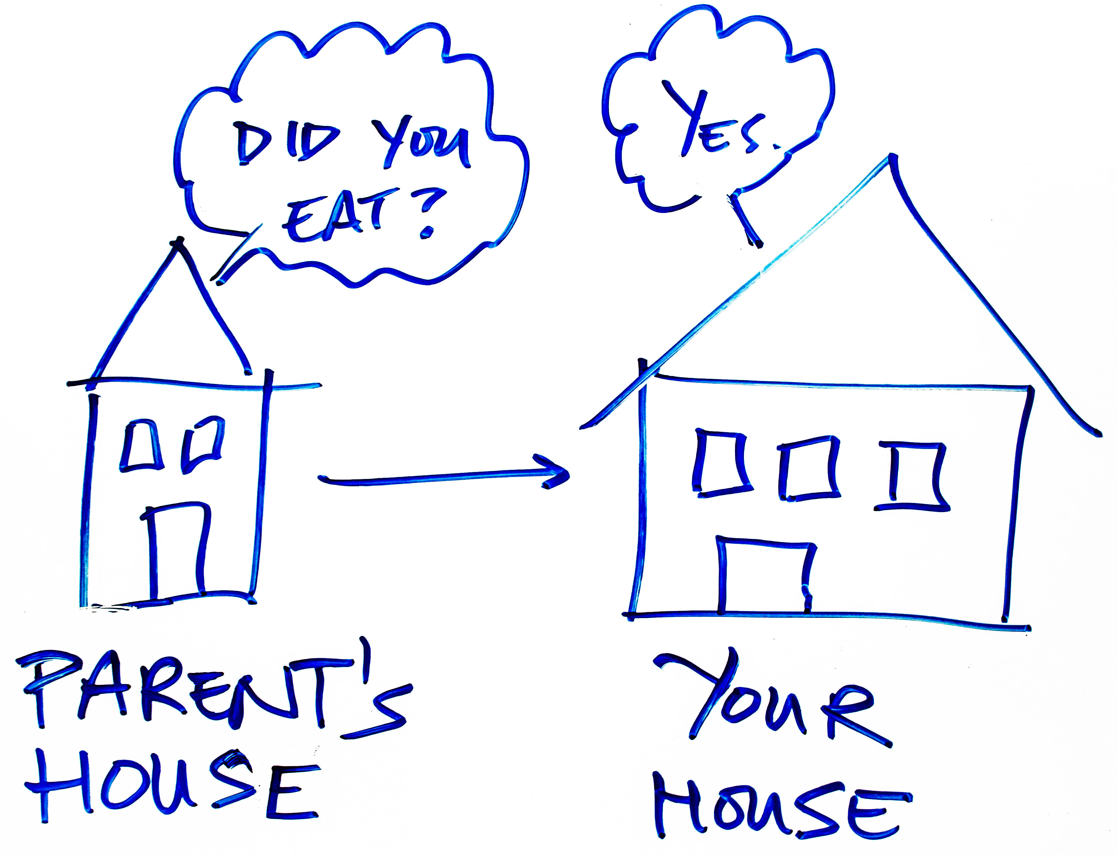
the dream
5
4
3
2
1

Slide 8
education excellence wealth FAMILY stability legacy

Slide 9
Next Generation of Leaders

Slide 10
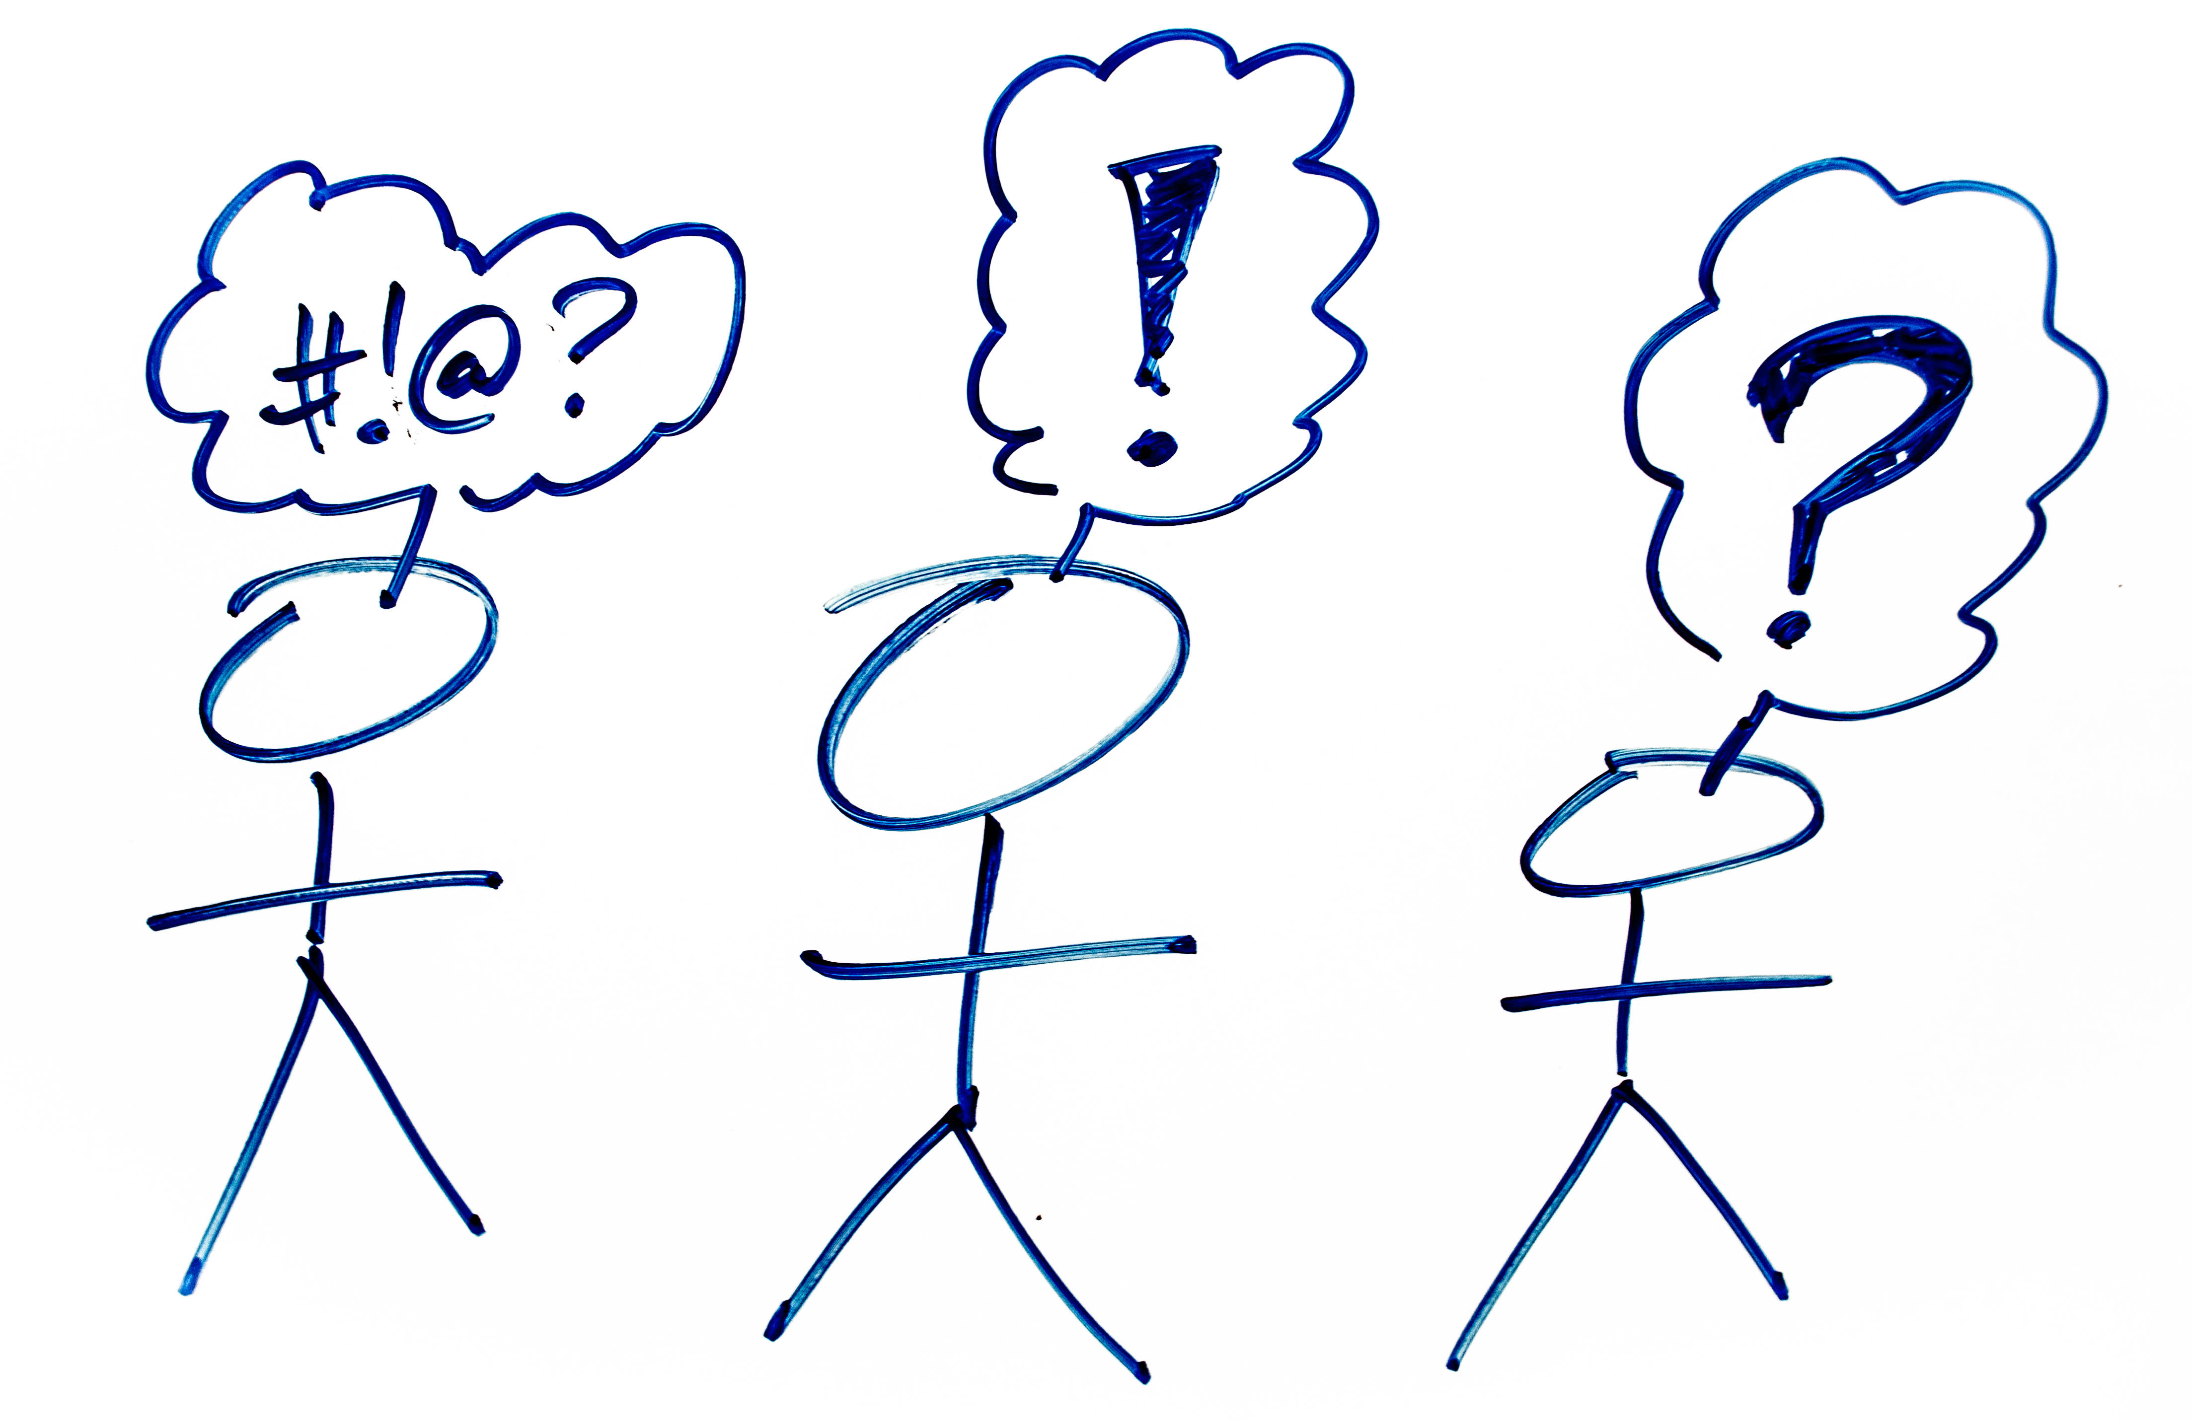
Contextualized Evangelism

Slide 11
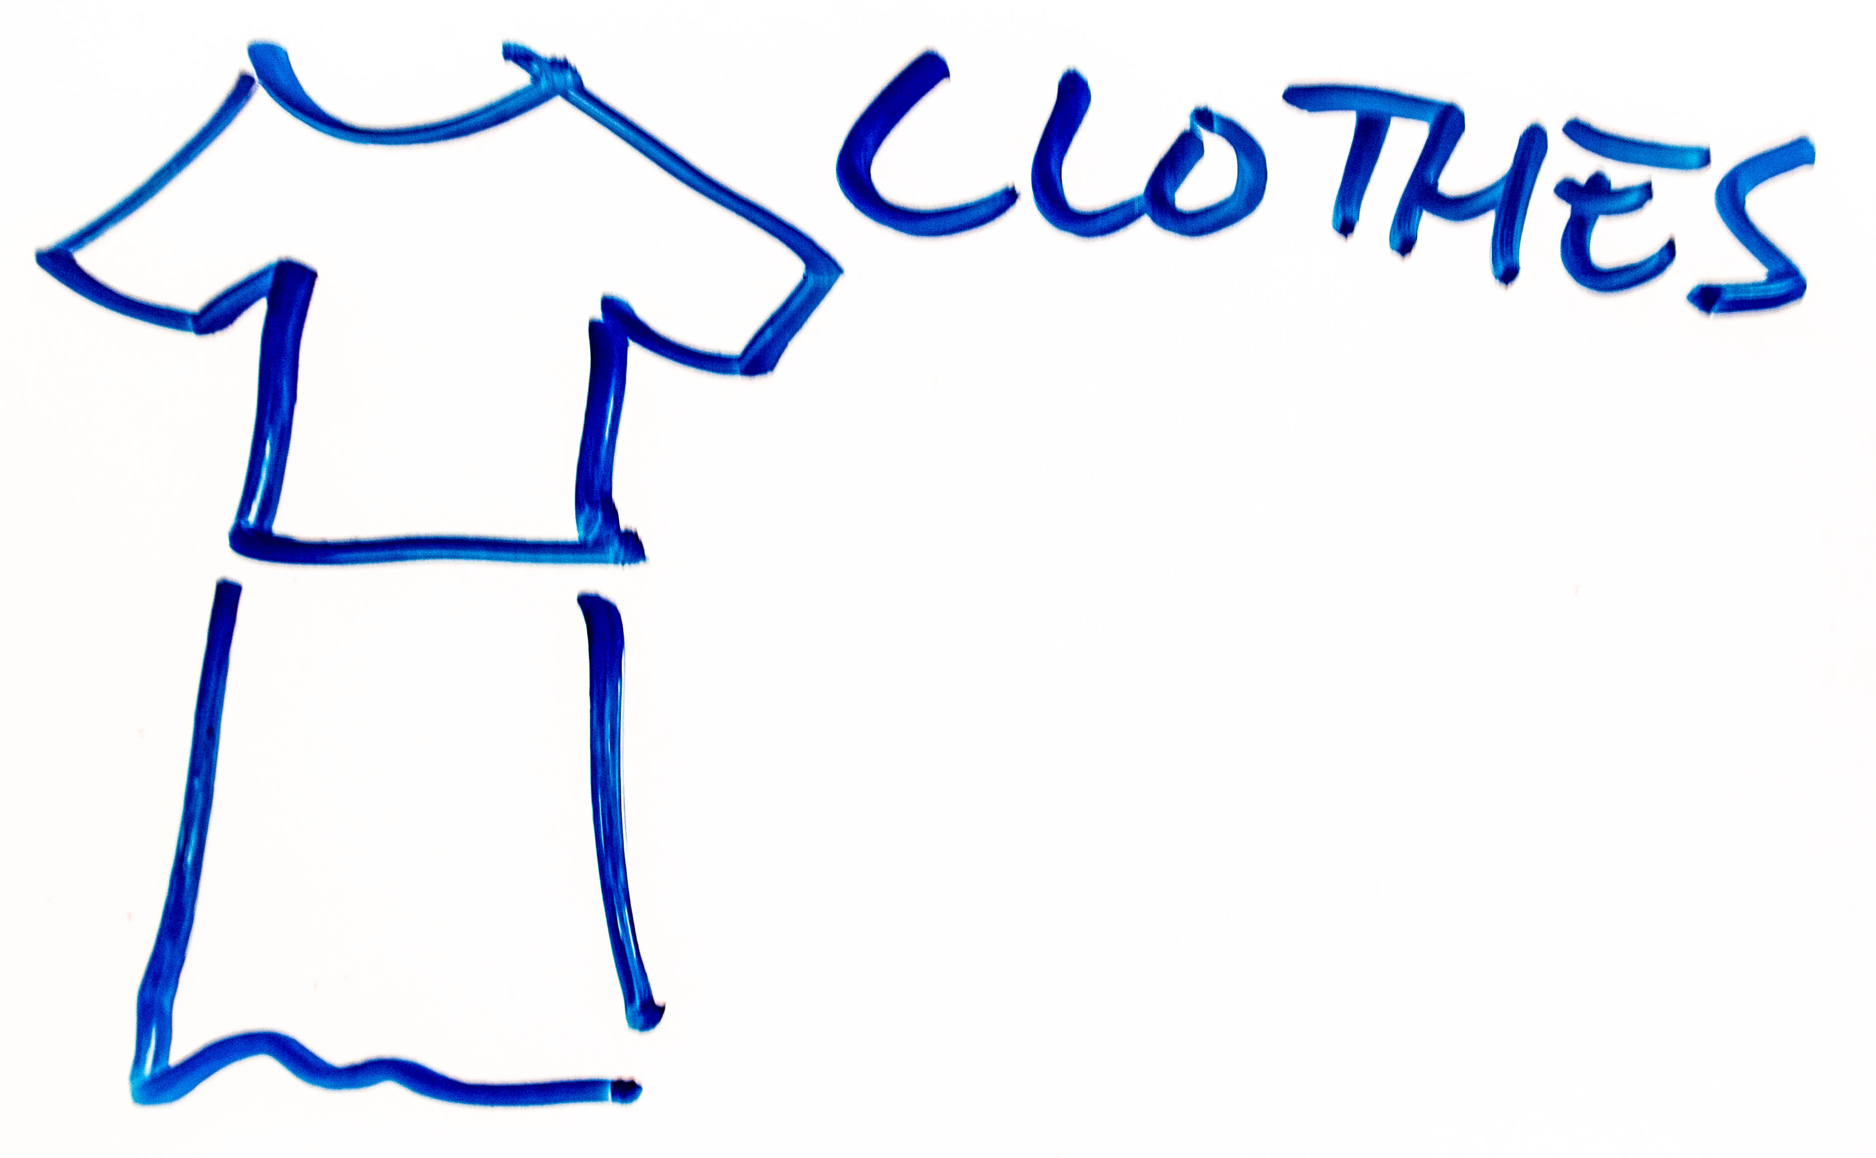
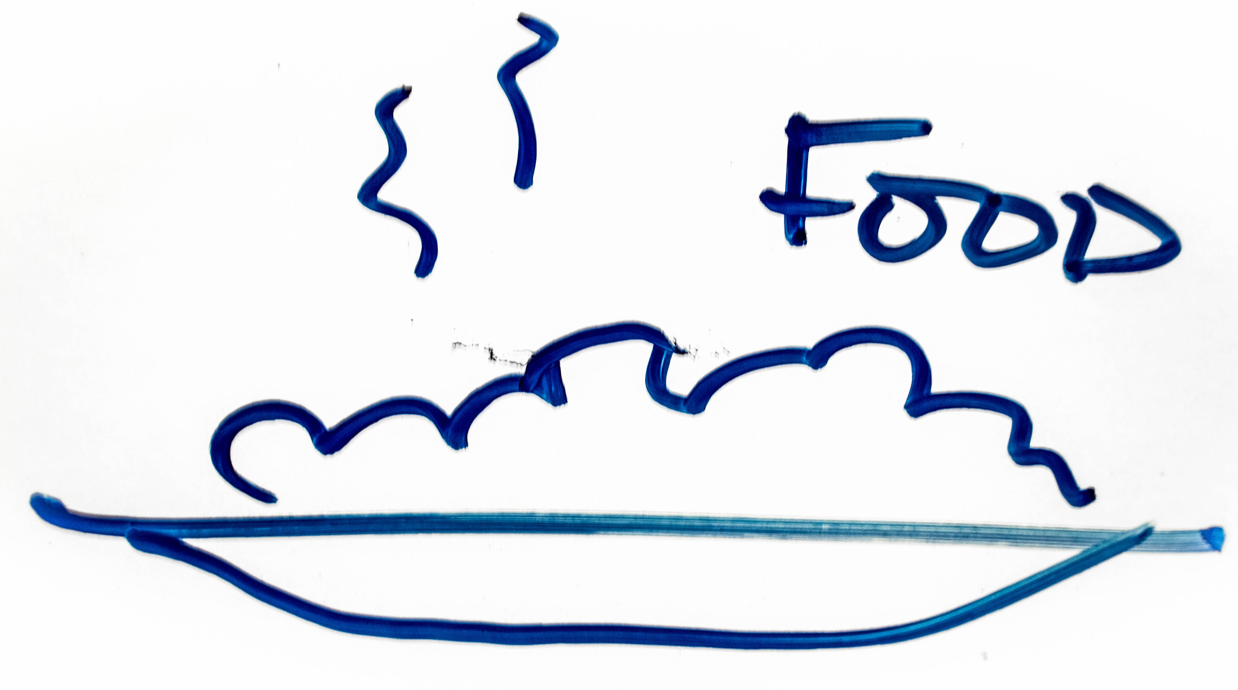
Renewal of our Culture

Slide 12
Our hope for South Asians

Slide 13
obey
discuss
listen

Slide 14
linsondaniel.com/urbana

